Slide 1
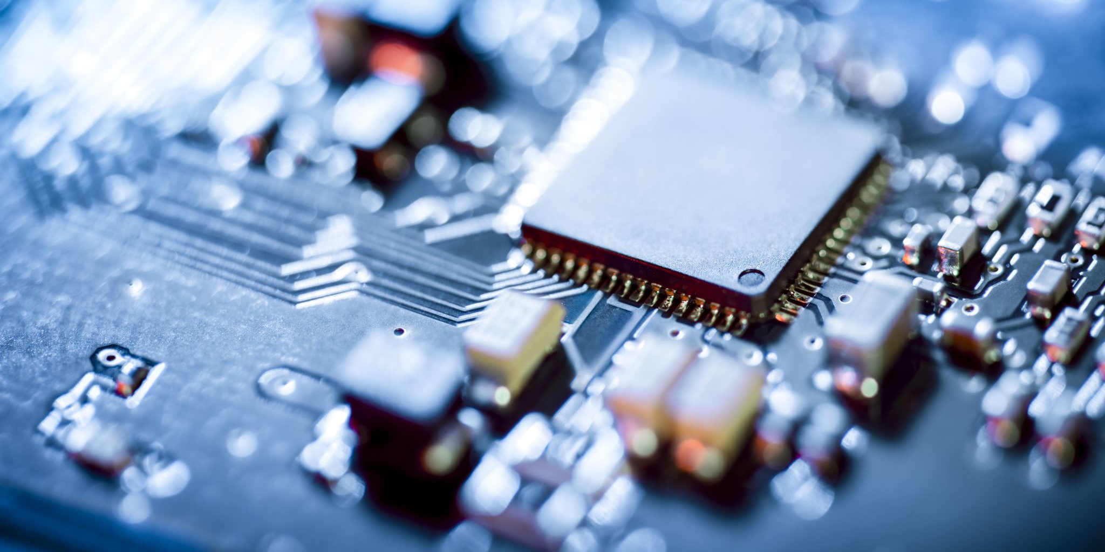

PWM Drawer
Powered by Atmega32

Slide 2
A method of encoding information based on variations of the duration of carrier pulses. Also called pulse duration modulation (PDM).
In this project, PWM is used in a simpler matter that is controlling the effective voltage applied to an external module.
For example: adjust the brightness of a LED or alter the speed of a DC motor.

Slide 3
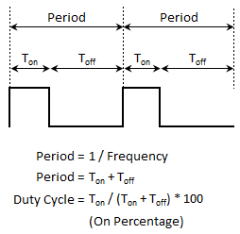
Parameters
The figure shows the 3 main para-
meters of PWM:
Frequency (f)
Period (T or 1/f)
Duty Cycle (d)
Basically duty cycle is how much
percentage does the ON time take
from the total pulse time.

Slide 4
Project Configuration
Fast PWM, non-inverting mode.
No prescaling (PWM_No_Prescaling).
PD7 is the output pin (internal PWM output).
PD6 is the input pin (PWM reading pin).

Slide 5
Display Mode
Since the frequency and the period can be easily obtained from one another through (f = 1/T), inside “main.h” file, a FREQ_MODE macro is used as follows:
If it’s set to 1 (default), the LCD will display the frequency and the duty cycle in addition to the waveform.
If it’s set to 0, the LCD will replace the frequency with the period and continue to show the other parameters as usual.
This is done to show as much necessary data as possible on the compact 16x2 LCD display based on user preference.

Slide 6
Modularity
APP
main.c
HAL
LCD (16x2) module
MCAL
PWM (TIMER2 peripheral)
ICU (TIMER1 peripheral)

Slide 7
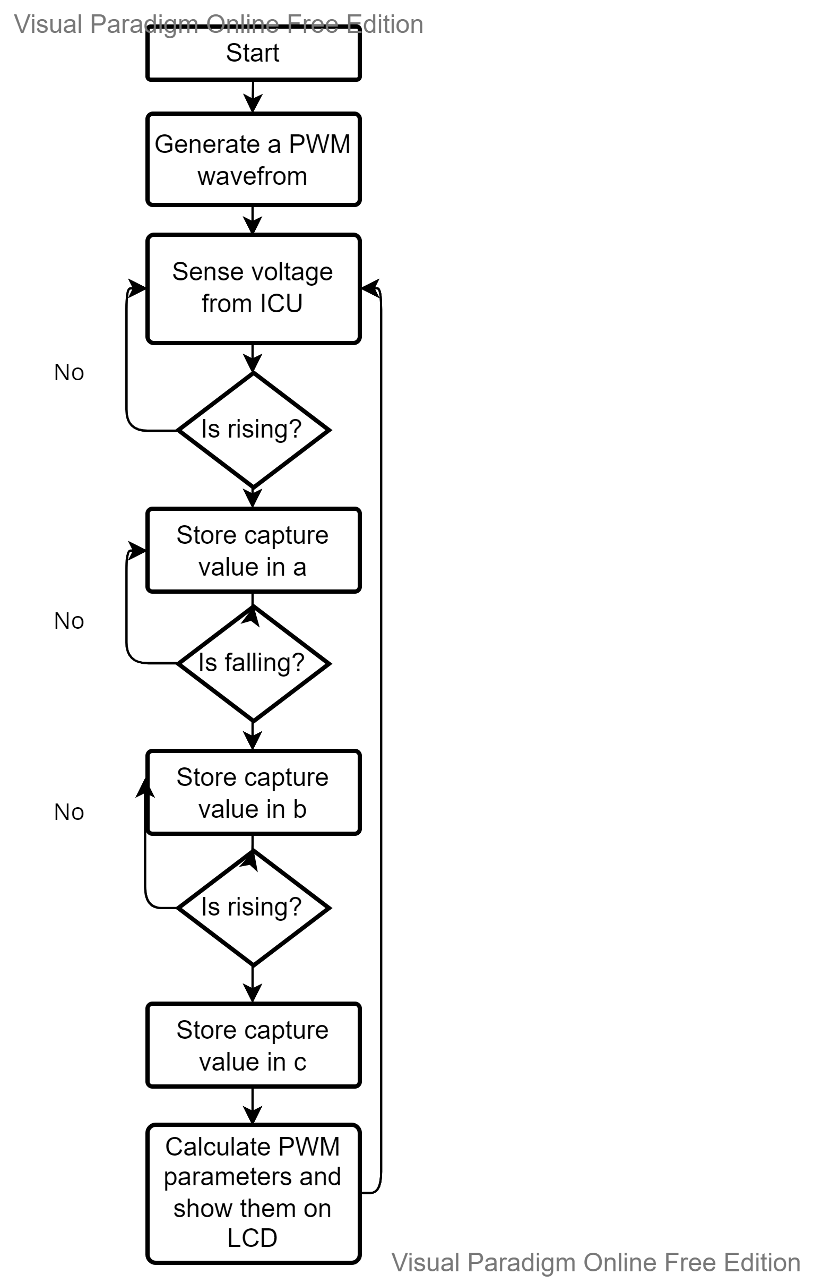
Flowchart
The following flowchart explains the
algorithm of the PWM drawer code.

Slide 8
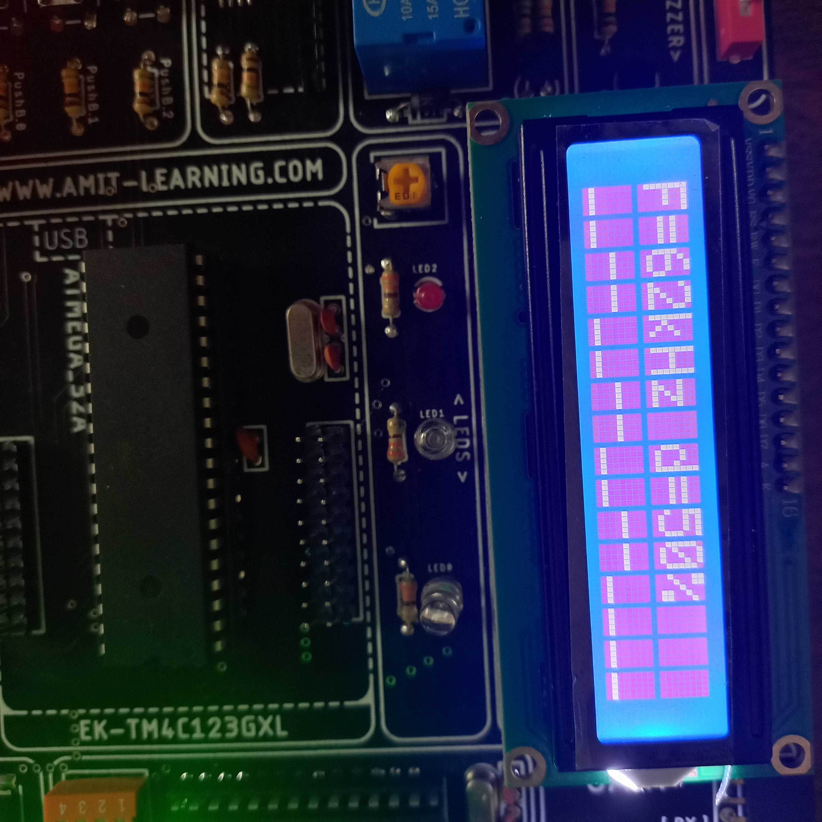
Preview 1
Duty Cycle = 50%
FREQ_MODE 1

Slide 9
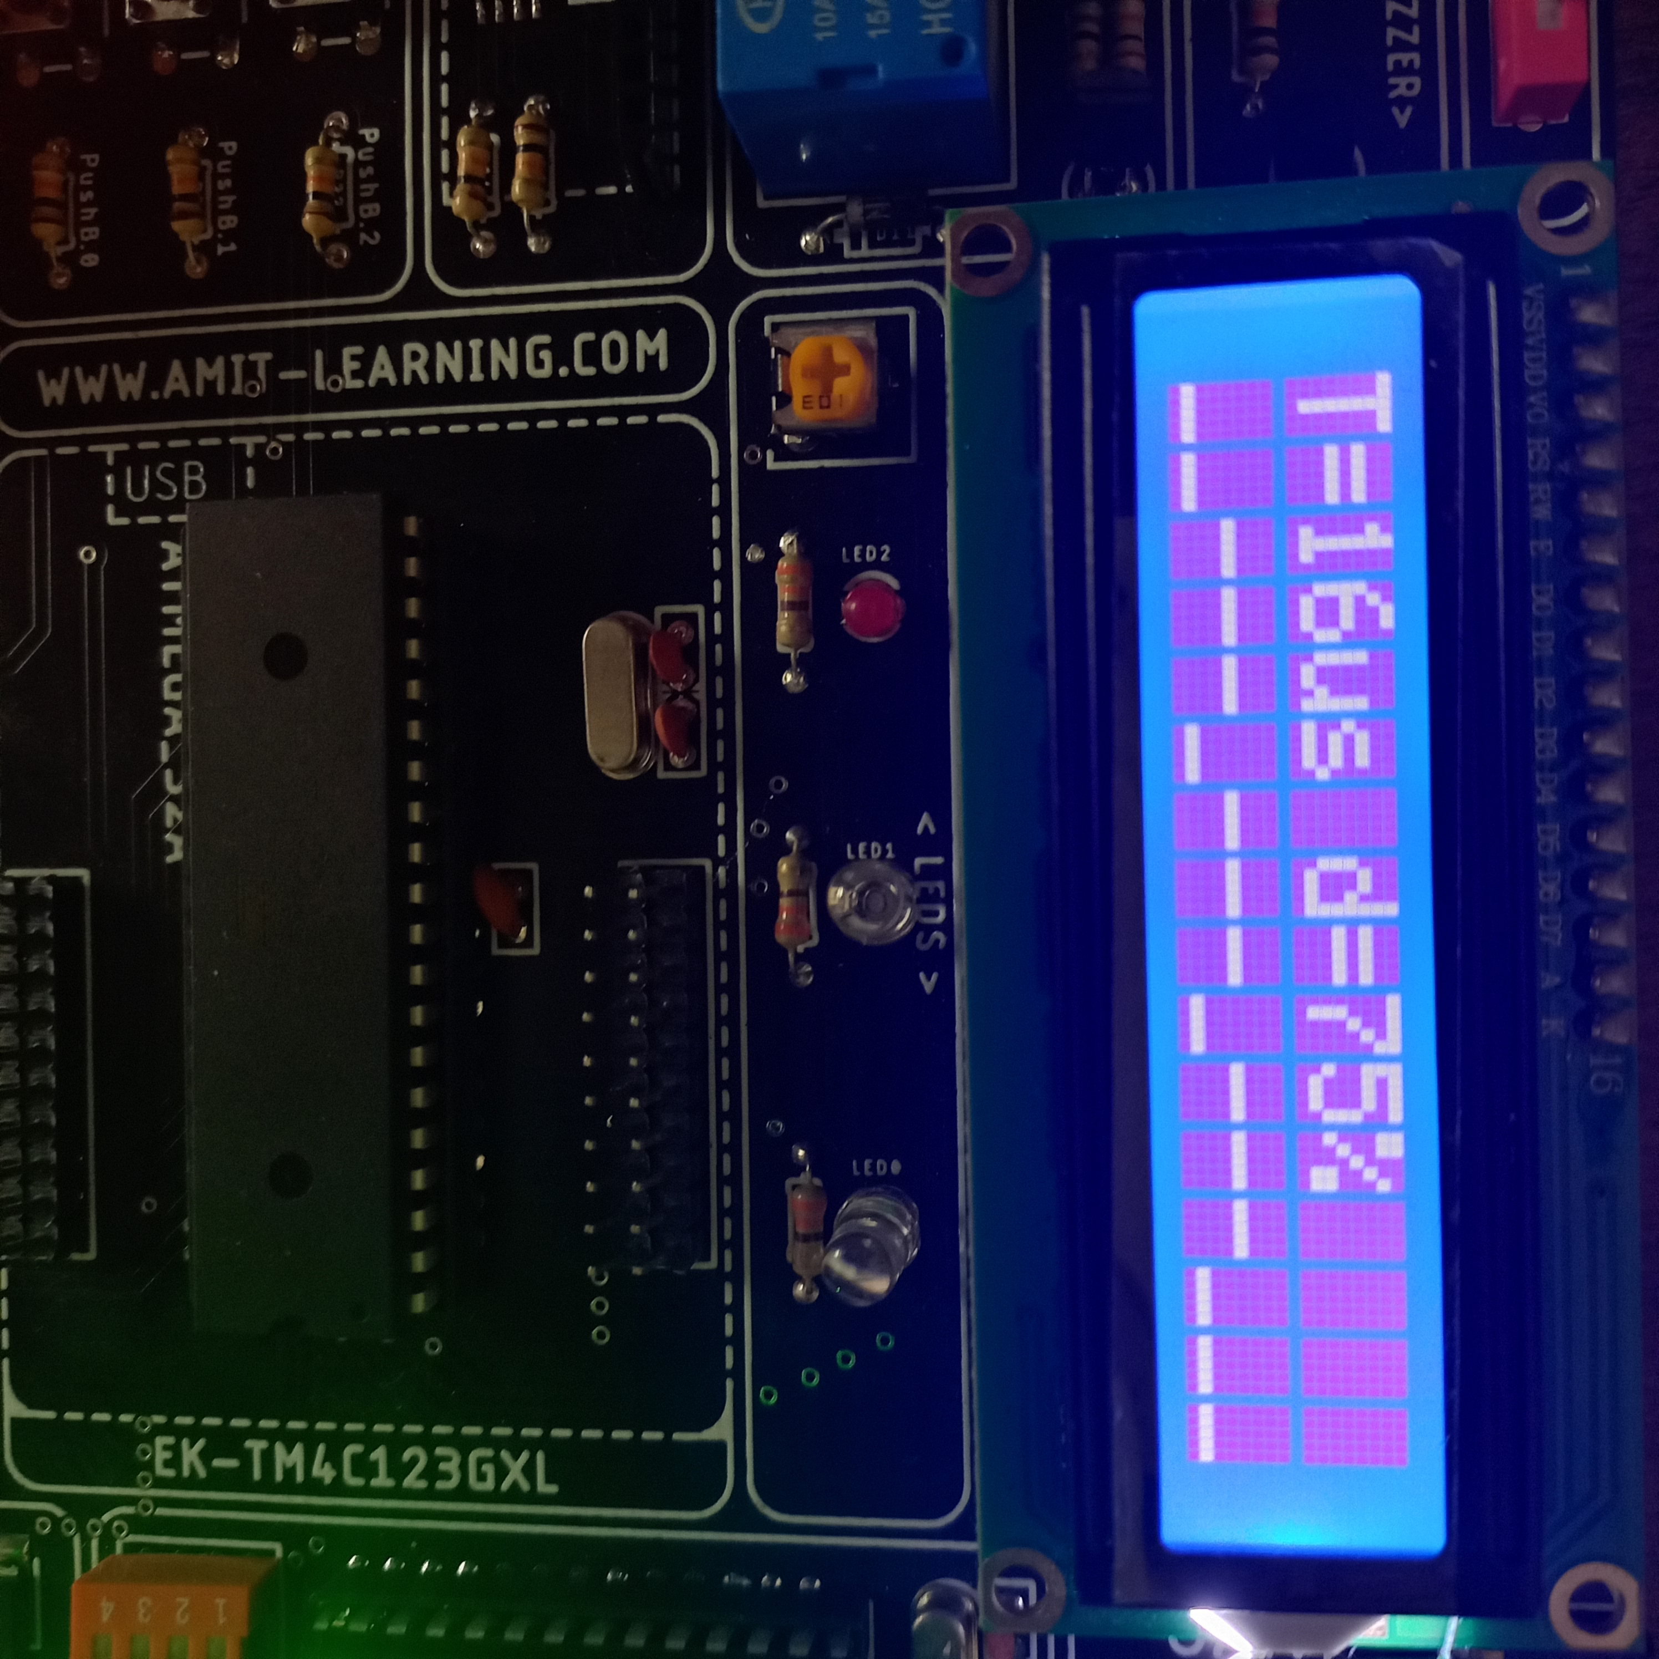
Preview 2
Duty Cycle = 75%
FREQ_MODE 0

